Slide 1

Chapter 15 Graphics

Slide 2
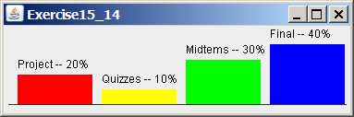
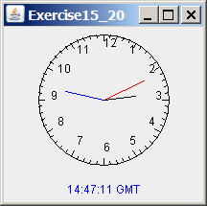
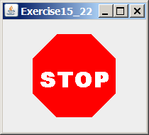
Motivations
If you want to draw shapes such as a bar chart, a clock, or a stop sign, how do you do it?

Slide 3
Objectives
To describe Java coordinate systems in a GUI component (§15.2).
To draw things using the methods in the Graphics class (§15.3).
To override the paintComponent method to draw things on a GUI component (§15.3).
To use a panel as a canvas to draw things (§15.3).
To draw strings, lines, rectangles, ovals, arcs, and polygons (§§15.4, 15.6-15.7).
To obtain font properties using FontMetrics and know how to center a message (§15.8).
To display an image in a GUI component (§15.11).
To develop reusable GUI components FigurePanel, MessagePanel, StillClock, and ImageViewer (§§15.5, 15.9, 15.10, 15.12).

Slide 4
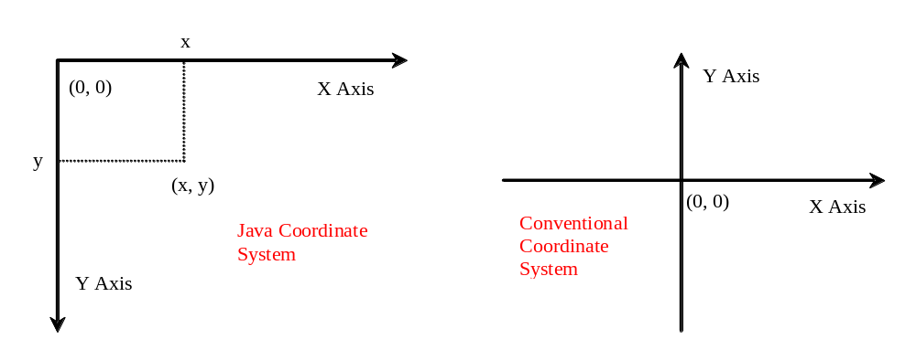
Java Coordinate System

Slide 5
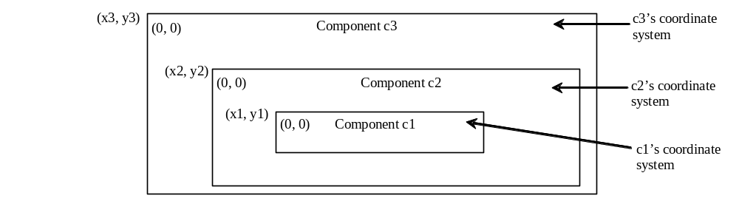
Each GUI Component Has its Own Coordinate System

Slide 6
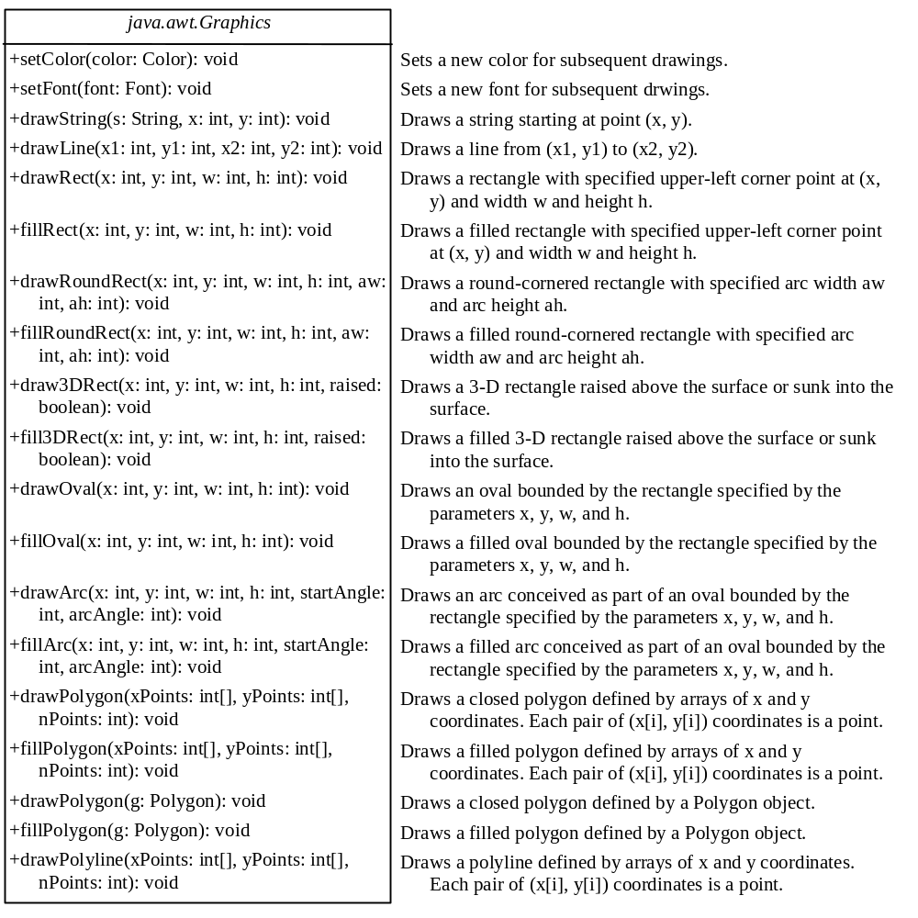
The Graphics Class
You can draw strings, lines, rectangles, ovals, arcs, polygons, and polylines, using the methods in the Graphics class.

Slide 7
paintComponent Example
In order to draw things on a component, you need to define a class that extends JPanel and overrides its paintComponent method to specify what to draw. The first program in this chapter can be rewritten using paintComponent.
TestPaintComponent
Run

Slide 8
Drawing Geometric Figures
Drawing Strings
Drawing Lines
Drawing Rectangles
Drawing Ovals
Drawing Arcs
Drawing Polygons

Slide 9
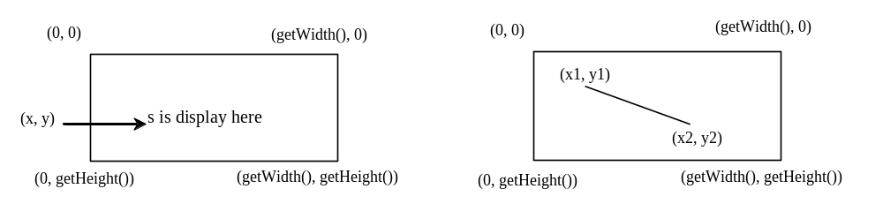
Drawing Strings
drawString(String s, int x, int y);
drawLine(int x1, int y1, int x2, int y2);

Slide 10
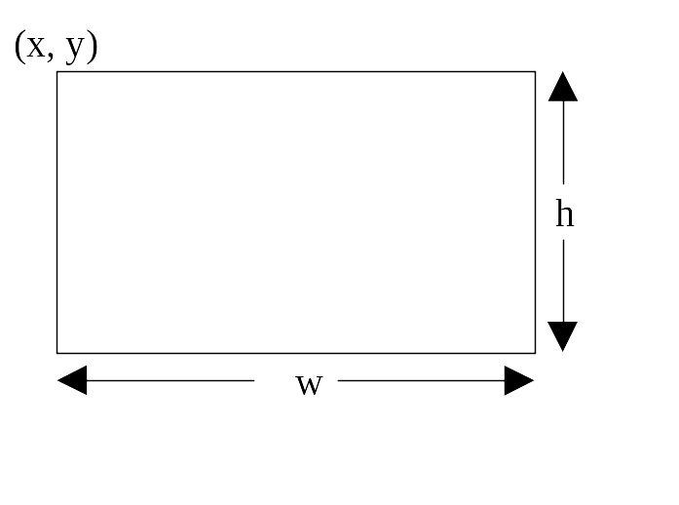
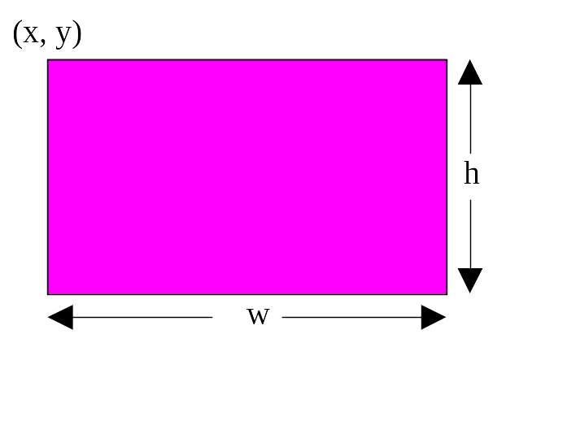
Drawing Rectangles
drawRect(int x, int y, int w, int h);
fillRect(int x, int y, int w, int h);

Slide 11
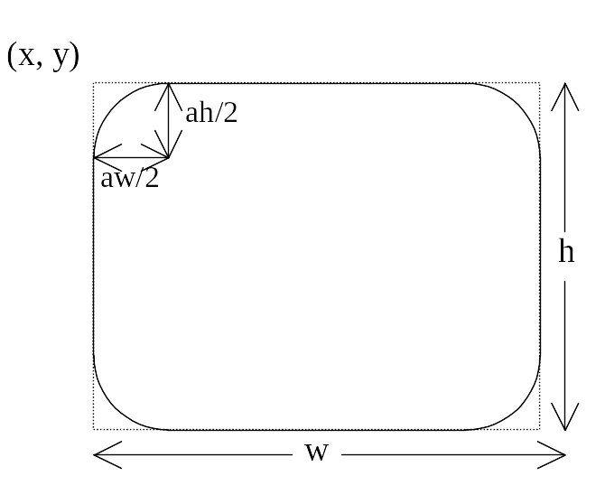
Drawing Rounded Rectangles
drawRoundRect(int x, int y, int w, int h, int aw, int ah);
fillRoundRect(int x, int y, int w, int h, int aw, int ah);

Slide 12
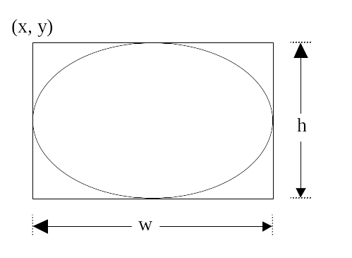
Drawing Ovals
drawOval(int x, int y, int w, int h);
fillOval(int x, int y, int w, int h);

Slide 13
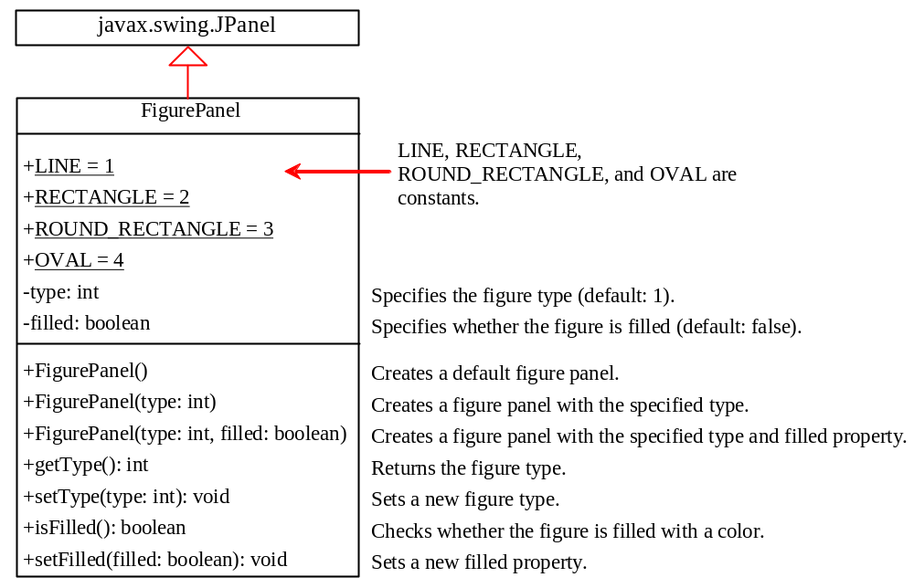
Case Study: The FigurePanel Class
This example develops a useful class for displaying various figures. The class enables the user to set the figure type and specify whether the figure is filled, and displays the figure on a panel.
FigurePanel

Slide 14
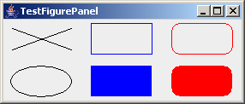
Test FigurePanel
This example develops a useful class for displaying various figures. The class enables the user to set the figure type and specify whether the figure is filled, and displays the figure on a panel.
TestFigurePanel
Run

Slide 15
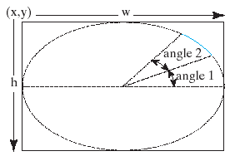
Drawing Arcs
drawArc(int x, int y, int w, int h, int angle1, int angle2);
fillArc(int x, int y, int w, int h, int angle1, int angle2);
Angles are in degree

Slide 16
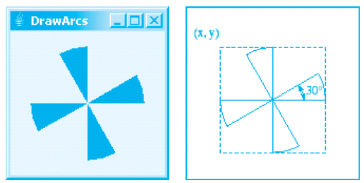
Drawing Arcs Example
DrawArcs
Run

Slide 17
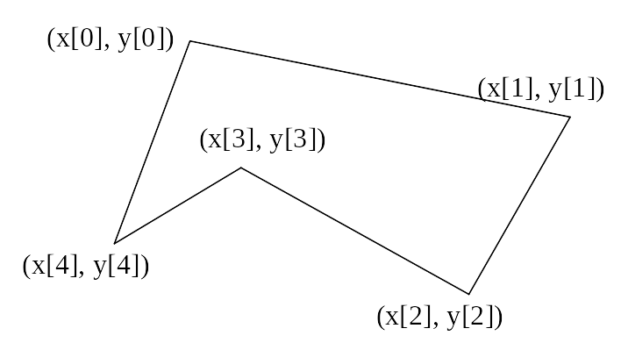
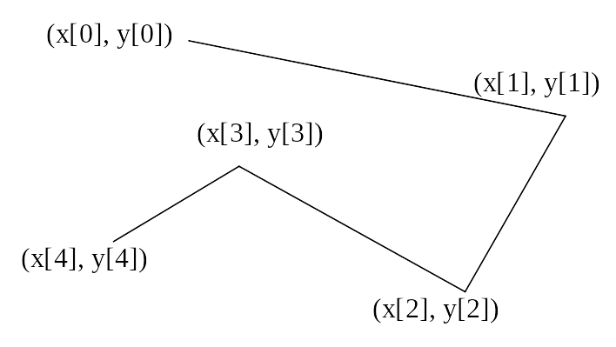
Drawing Polygons and Polylines
int[] x = {40, 70, 60, 45, 20};
int[] y = {20, 40, 80, 45, 60};
g.drawPolygon(x, y, x.length);
g.drawPolyline(x, y, x.length);

Slide 18
Drawing Polygons Using the Polygon Class
Polygon polygon = new Polygon();
polygon.addPoint(40, 59);
polygon.addPoint(40, 100);
polygon.addPoint(10, 100);
g.drawPolygon(polygon);

Slide 19
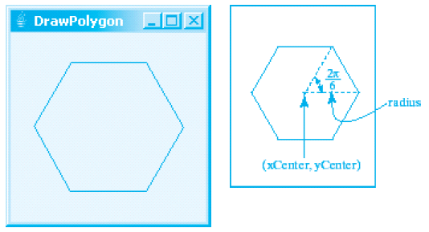
Drawing Polygons Example
DrawPolygon
Run

Slide 20
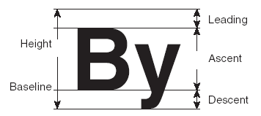
Centering Display Using the FontMetrics Class
You can display a string at any location in a panel. Can you display it centered? To do so, you need to use the FontMetrics class to measure the exact width and height of the string for a particular font. A FontMetrics can measure the following attributes:
public int getAscent()
public int getDescent()
public int getLeading()
public int getHeight()
public int stringWidth(String str)
getLeading()
getHeight()
getAscent()
getDescent()

Slide 21
The FontMetrics Class
FontMetrics is an abstract class. To get a FontMetrics object for a specific font, use the following getFontMetrics methods defined in the Graphics class:
  · public FontMetrics getFontMetrics(Font f)
Returns the font metrics of the specified font.
  · public FontMetrics getFontMetrics()
Returns the font metrics of the current font.

Slide 22
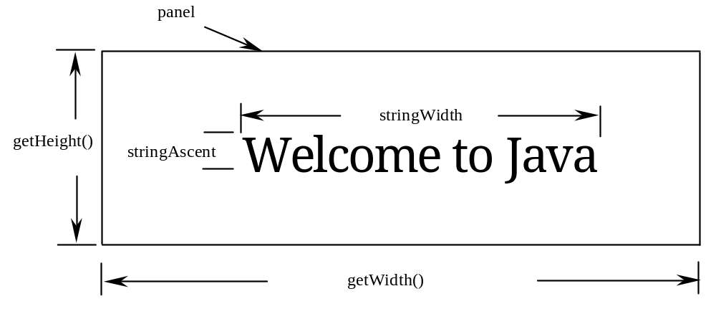
TestCenterMessage
Run

Slide 23
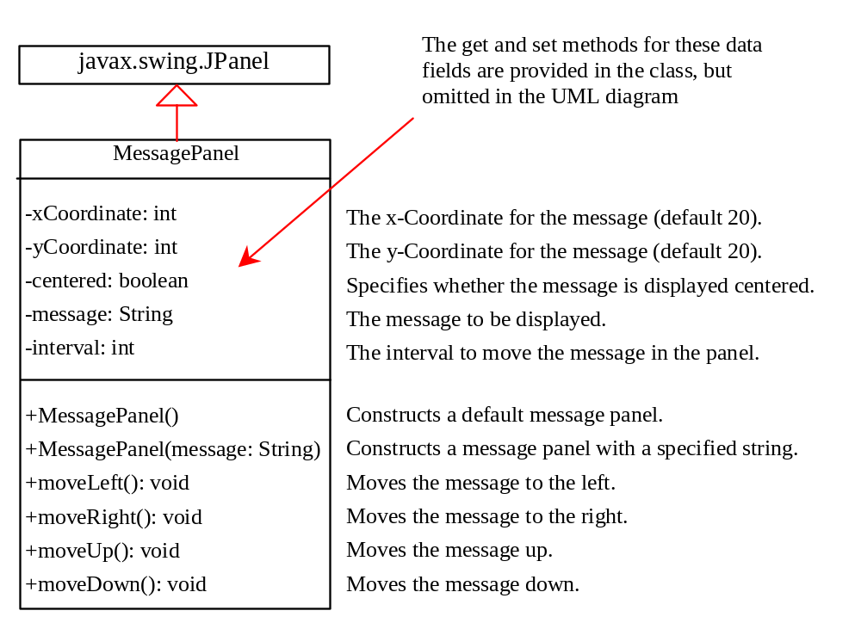
Case Study: MessagePanel
This case study develops a useful class that displays a message in a panel. The class enables the user to set the location of the message, center the message, and move the message with the specified interval.
MessagePanel
TestMessagePanel
Run

Slide 24
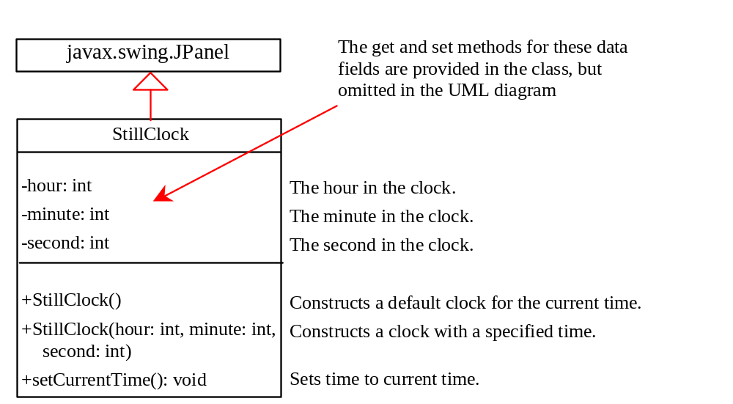
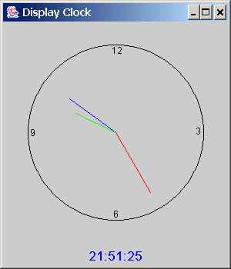
Case Study: StillClock
StillClock
DisplayClock
Run

Slide 25
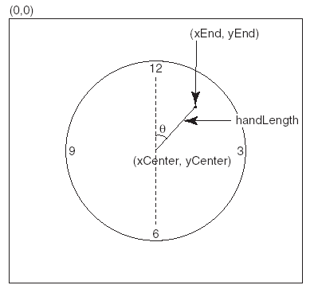
Drawing Clock
xEnd = xCenter + handLength × sin(θ)
yEnd = yCenter - handLength × cos(θ)
Since there are sixty seconds in one minute, the angle for the second hand is
second × (2π/60)

Slide 26
Drawing Clock, cont.
xEnd = xCenter + handLength × sin(θ)
yEnd = yCenter - handLength × cos(θ)
The position of the minute hand is determined by the minute and second. The exact minute value combined with seconds is minute + second/60. For example, if the time is 3 minutes and 30 seconds. The total minutes are 3.5. Since there are sixty minutes in one hour, the angle for the minute hand is
(minute + second/60) × (2π/60)

Slide 27
Drawing Clock, cont.
xEnd = xCenter + handLength × sin(θ)
yEnd = yCenter - handLength × cos(θ)
Since one circle is divided into twelve hours, the angle for the hour hand is
(hour + minute/60 + second/(60 × 60))) × (2π/12)

Slide 28
Displaying Image Icons
You learned how to create image icons and display image icons in labels and buttons. For example, the following statements create an image icon and display it in a label:
ImageIcon icon = new ImageIcon("image/us.gif");
JLabel jlblImage = new JLabel(imageIcon);
An image icon displays a fixed-size image. To display an image in a flexible size, you need to use the java.awt.Image class. An image can be created from an image icon using the getImage() method as follows:
Image image = imageIcon.getImage();

Slide 29
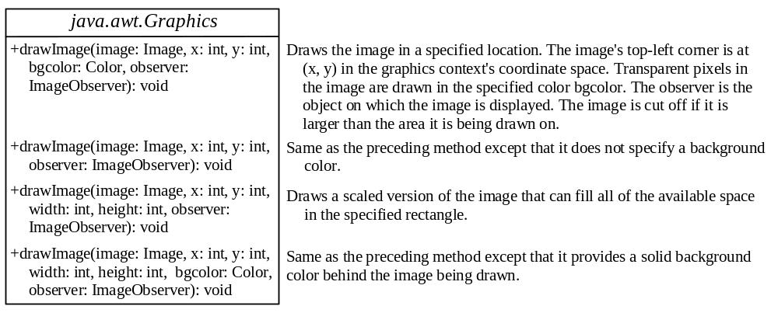
Displaying Images
Using a label as an area for displaying images is simple and convenient, but you don't have much control over how the image is displayed. A more flexible way to display images is to use the drawImage method of the Graphics class on a panel. Four versions of the drawImage method are shown here.

Slide 30
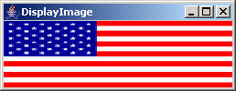
Displaying Images Example
This example gives the code that displays an image from image/us.gif. The file image/us.gif is under the class directory. The Image from the file is created in the program. The drawImage method displays the image to fill in the whole panel, as shown in the figure.
DisplayImage
Run

Slide 31
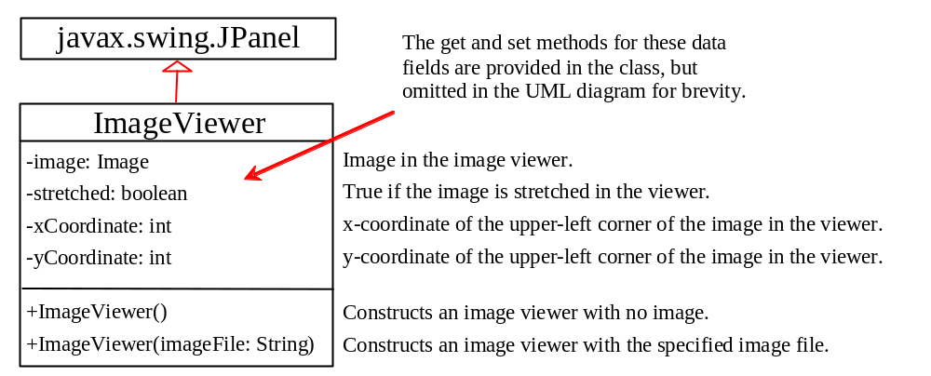
Case Study: ImageViewer Class
Displaying an image is a common task in Java programming. This case study develops a reusable component named ImageViewer that displays an image in a panel. The ImageViewer class contains the properties image, imageFilename, stretched, xCoordinate, and yCoordinate.

Slide 32
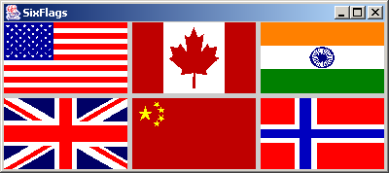
ImageView Example
This example gives an example that creates six images using the ImageViewer class.
SixFlags
Run

